Slide 1


Mock Autosar
GROUP 2:
Trung
Long
Ninh
21 – 8 – 2024

Slide 2
1
1
Overview
Content
2
Design Architecture
3
Design Can Message
4
Sequence Diagram
© Copyright FPT Software – Level of Confidentiality

Slide 3
01. Overview

Slide 4
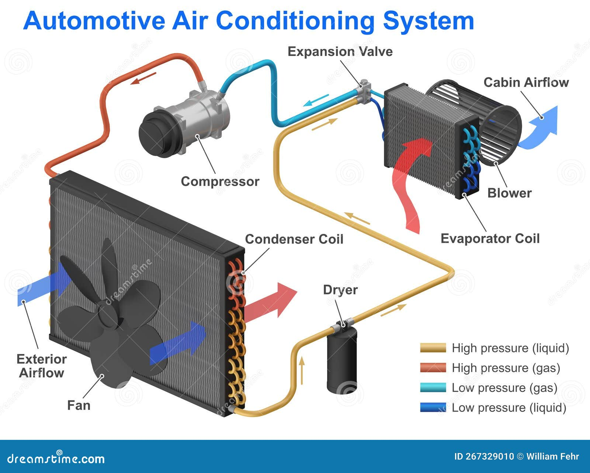
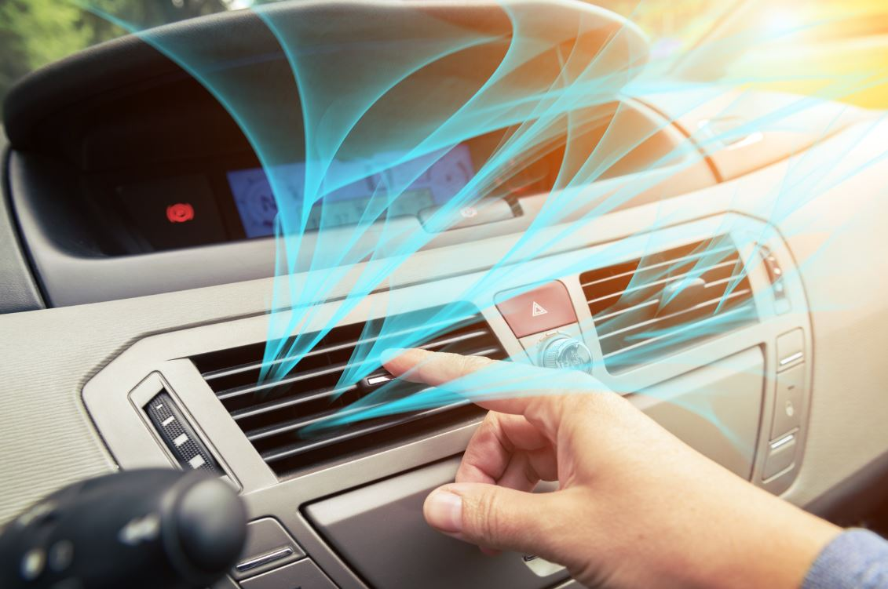
Overview
Objective: Automotive air conditioning system
Key Features:
Control the cabin temperature (cooling or heating)
Adjust fan speed
Automatic temperature control based on user settings
Requirements:
2 ECU
Communication via CAN bus
Simple and minimalist design

Slide 5
02. Design Architecture

Slide 6
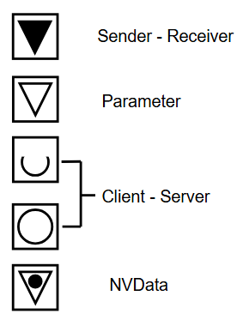
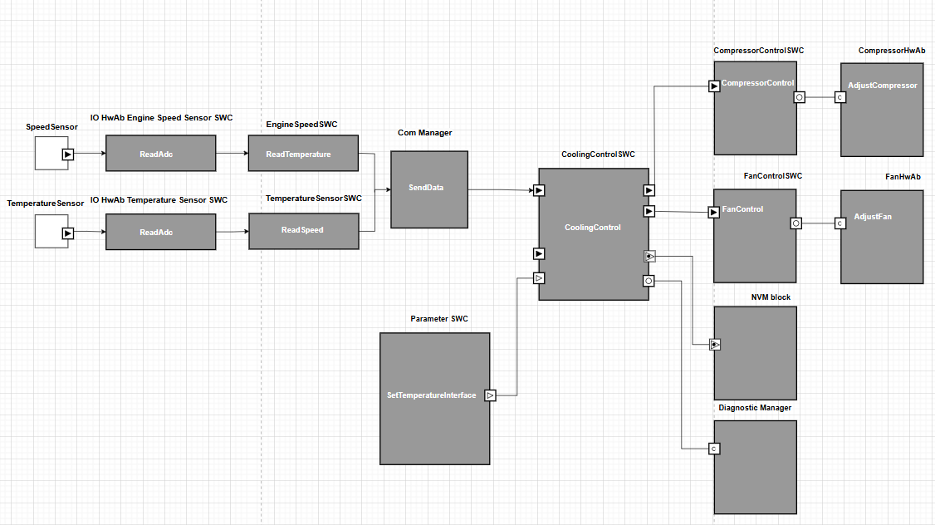
Design Architecture
SWC Architecture Diagram

Slide 7
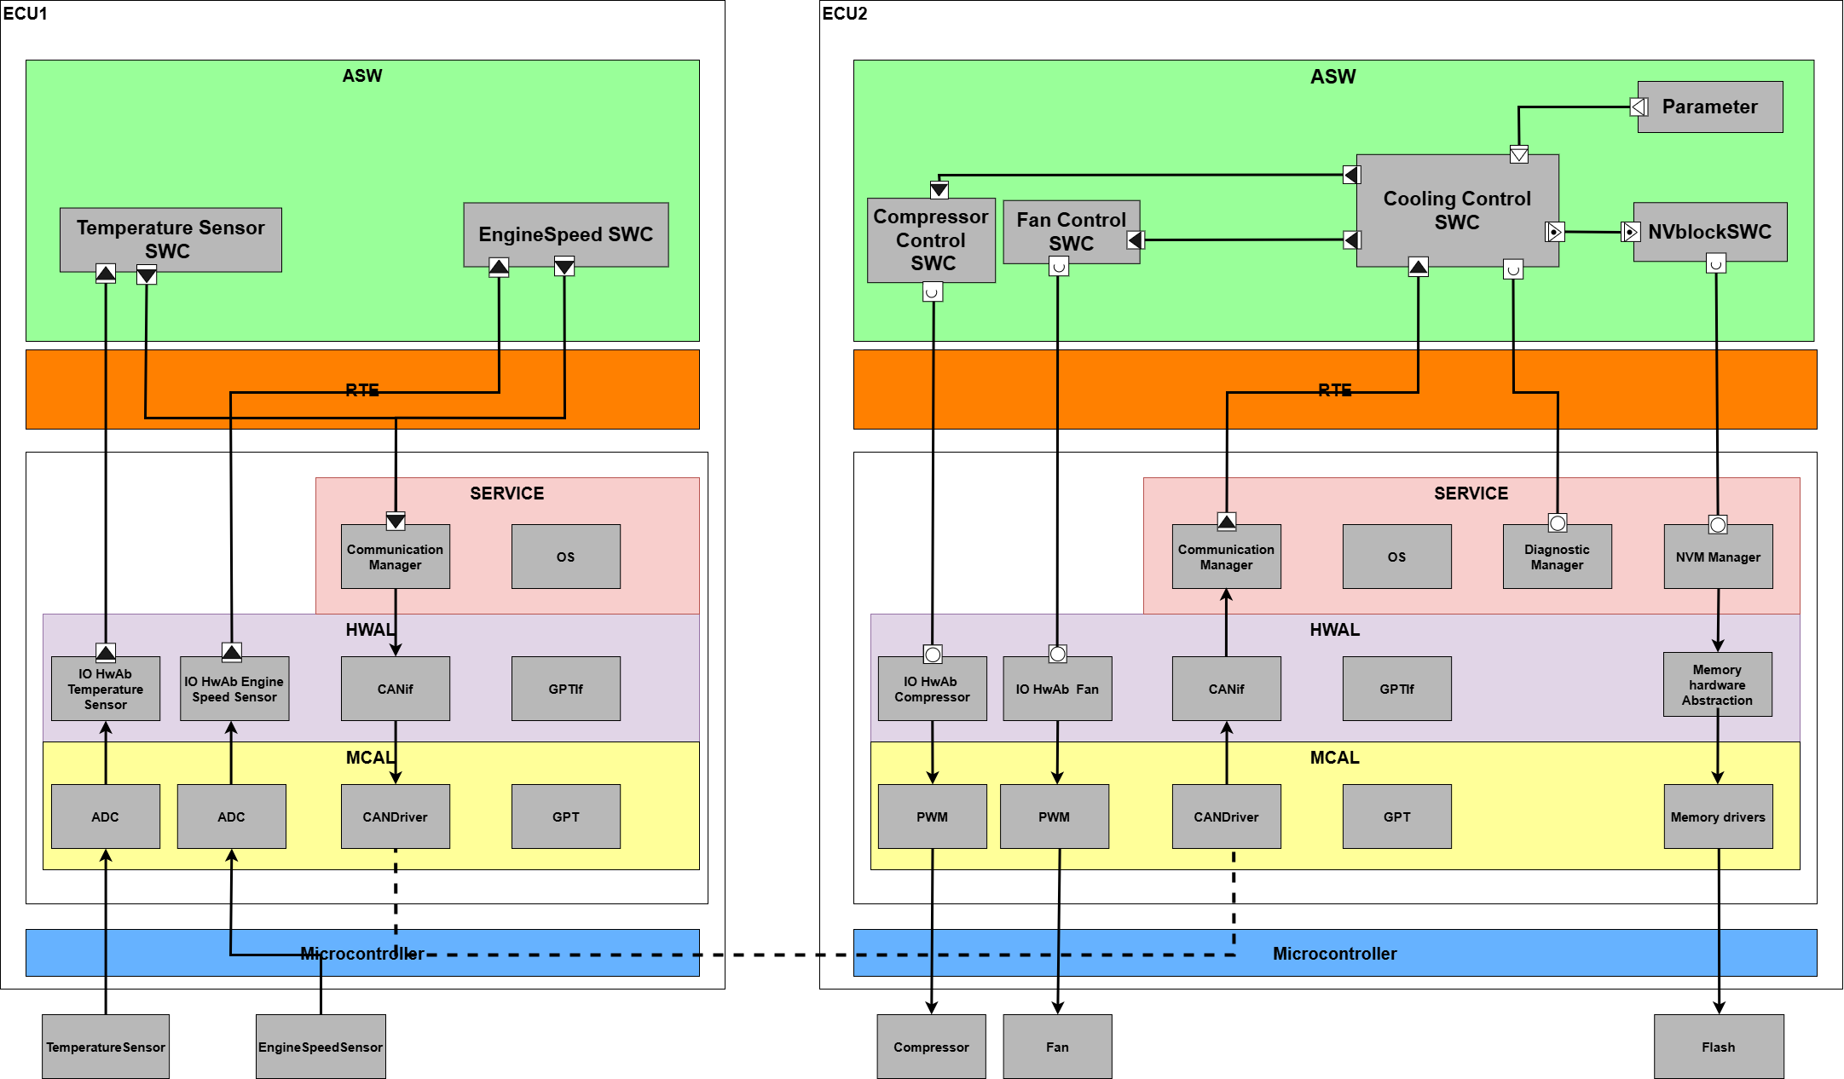
Design Architecture
ECU Architecture Diagram

Slide 8
Design Architecture
Define Runnables and Events:
ECUs | SWCs | Runnables | Events | Decription
ECU_01 | TemperatureSensorSWC | ReadTemperature_Runable | Data Received Event | Receive raw data from BSW and process it into temperature, transmit it through CoolingControlSWC
 | EngineSpeedSWC | ReadSpeed_Runable | Data Received Event | Receive raw data from BSW and process it into engine speed, transmit it via CoolingControlSWC
 | IOHwAbTemperatureSensor | ReadVoltage_Runable | Timing Event (10ms) | Read temperature sensor and send raw data to ASW
 | IOHwAbEngineSpeedSensor | ReadPulse_Runable | Timing Event (10ms) | Read engine speed sensor and send raw data to ASW
ECU_02 | CoolingControlSWC | CoolingControl_Runable | Data Received Event | Logic processing and control signal output
 | FanControlSWC | FanControl_Runable | Data Received Event | Receive signal from main controller and call runnable to control fan
 | CompressorControlSWC | CompressorControl_Runable | Data Received Event | Receive signal from main controller and call runnable to control refrigeration compressor.
 | IOHwAbFan | AdjustFan_Runable | Operation Invoked Event | Fan control
 | IOHwAbCompressor | AdjustCompressor_Runable | Operation Invoked Event | Refrigeration compressor control
 | NVBlockSWC | HandleNVM_Runnable | Data Received Event | Receive NV data from CoolingControlSWC

Slide 9
Design Architecture
Define Port:
ECU | Ports | Runnable mapped | Port Interface | Description
ECU_01 | PP_Voltage | ReadVoltage_Runable | Sender-Receiver (S/R) | Send voltage data from HWAb to SWC.
 | RP_Voltage | ReadTemperature_Runable
 | PP_Temperature | ReadTemperature_Runable | Sender-Receiver (S/R) | Send temperature data from SWC to COM.
 | PP_Pulse | ReadPulse_Runable | Sender-Receiver (S/R) | Send pulse data from HWAb to SWC.
 | RP_Pulse | ReadSpeed_Runable
 | PP_Speed | ReadSpeed_Runable | Sender-Receiver (S/R) | Send engine speed data from SWC to COM.

Slide 10
Design Architecture
ECU | Ports | Runnable mapped | Port Interface | Description
ECU_02 | RP_ComData | CoolingControl_Runable | Sender-Receiver (S/R) | SWC receives data sent from Communication Manager.
 | PP_FanData | CoolingControl_Runable | Sender-Receiver (S/R) | Send fan control commands from Cooling Control SWC to Fan Control SWC.
 | RP_FanData | FanControl_Runable
 | PP_CompressorData | CoolingControl_Runable | Sender-Receiver (S/R) | Send compressor control command from Cooling Control SWC to Compressor Control SWC.
 | RP_CompressorData | CompressorControl_Runable
 | RP_AdjustFan | FanControl_Runable | Client-Server (C/S) | Send compressor control command from Fan Control SWC to IOHwAbFan.
 | RP_AdjustCompressor | CompressorControl_Runable | Client-Server (C/S) | Send compressor control command from Compressor Control SWC to IOHwAbCompressor.
 | RP_Error | CoolingControl_Runable | Client-Server (C/S) | Report faults from Cooling Control SWC to Diagnostic Manager or query fault status from DEM.
 | RP_SaveNVData | HandleNVM_Runnable | Client-Server (C/S) | NVBlockSWC requests NVM to write data to EEPROM/Flash.
 | RP_GetNVData | HandleNVM_Runnable | Client-Server (C/S) | NVBlockSWC requests NVM to read data to EEPROM/Flash.
 | RP_Param | CoolingControl_Runable | Parameter | Get default data from Parameter module to simulate initial value.
 | PP_NVData | CoolingControl_Runable | NV Data | Send/receive configuration data from NWblockSWC for storage or use.
 | RP_NVData | HandleNVM_Runnable
Define Port:

Slide 11
Design Architecture
Define Task:
ECU | Task Name | Runnable | Attributes
 |  |  | Priority | Type | Schedule | AutoStart | Size
ECU_01 | ReadSensor_Task | ReadVoltage_Runable | 15 | BASIC | Preemptive | FALSE | 50
 |  | ReadPulse_Runable
 | DataHandle_Task | ReadTemperature_Runable | 14 | EXTENDED | Preemptive | TRUE | 50
 |  | ReadTorque_Runable
ECU_02 | ComReceive_Task | Com_ReceiveSignal | 15 | BASIC | Preemptive | FALSE | 50
 | Main_Task | CoolingControl_Runable | 14 | EXTENDED | Preemptive | TRUE | 50
 | Component_Task | FanControl_Runable | 13 | EXTENDED | Preemptive | TRUE | 50
 |  | CompressorControl_Runable

Slide 12
Design Architecture
Mapping rte event and os event:
Task | RTE Event | RTE Event | OS Event Mapped
ReadSensor_Task | Timing Event | Alarm | Alarm event
DataHandle_Task | Data Received Event | BE_ReadSensor | Basic event
ComReceive_Task | Data Received Event | Alarm | Alarm event
Main_Task | Data Received Event | BE_Receive | Basic event
Component_Task | Data Received Event | BE_Signal | Basic event

Slide 13
03. CAN Design

Slide 14
CAN Design
CAN Network Structure
CAN_TX_SENSOR_DATA
ECU1
ECU2

Slide 15
CAN Design
Message and signals from ECU1
Signal: EngineSpeed
Startbit: 0 Length: 8bit
Range: [0,100] ValueTable: No
Init Val: 0 DataType: UINT
Factor: 100 Unit: rpm
Comment: Tells the engine speed in rpm
0 rpm to 10000 rpm
Message : SensorData
CAN ID: 0xF1
DLC: 2
Periodicity: 10ms
Comments: From Airbag ECU, forwarded by CGW. Contains crash information
Signal: Temperature
Startbit: 8 Length: 8bit
Range: [0,100] ValueTable: No
Init Val: 0 DataType: UINT
Factor: 1 Offset: -30 Unit: rpm
Comment: Tells the engine speed in rpm
-30 °C to 70 °C

Slide 16
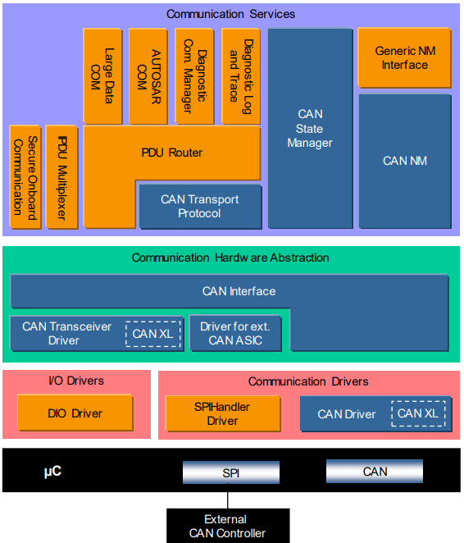
CAN Design

Slide 17
04. Diagnostic Event Manager

Slide 18
DEM
ERROR | DTC | Status | Description
EVENT_ID_TEMPERATURE_SENSOR_ERROR | 0X01 | 0x01 | Temperature out of range
 |  | 0X02
EVENT_ID_ENGINESPEED_SENSOR_FAILURE | 0X02 | 0X01 | Engine speed out of range
 |  | 0X02

Slide 19
05. NVM, WDG

Slide 20
NVM
Cooling Control SWC
Rte_Call_RP_NVData_CallServerFunction
NVBlock SWC
Rte_Call_RP_NVHandle_SeverHandle
NVM Manager

Slide 21
WDG
Supervisor Entity | Description | Supervisor Mechanism
SEID_SENSOR_ERROR | Supervisor in case of failing in reading sensor signal -> Recover (Stop control actuator, delay 1s for next reading signal) | Alive Supervisor

Slide 22


